Slide 1
SALES PREDICTOR FOR
SUPERMARKET
By-
Perumalla Dharan - AP21110010201
Pavan Sastry NVSS - AP21110010209
Phalgun Vatala - AP21110010223
Grandhi Dinesh - AP21110010240
Gurram V S Rehan - AP21110010259

Slide 2
TABLE OF CONTENTS
Abstract
Motivation
Goal
Methodology in detail
Result/outcome

Slide 3
Abstract
This project revolves around building a predictive model for Supermarket using sales data collected in 2013.
In this project, we're looking at sales data from Supermarket. They have data about 1559 products in 10 stores in different cities.
Supermarket wants to use this model to figure out what things about products and stores help sales the most. This will help them make better plans to make more money.

Slide 4
Motivation
Adapting to change in customer’s buying behavior
Bringing hidden insights from the data
Super market’s staying competitive.

Slide 5
Goal
To develop a predictive model
Analyze the relationship between various product.
Factors influencing sales.
How to increase profits.

Slide 6
Methodology in Detail
About Data Set
Data Preprocessing
Exploratory Data Analysis(EDA)
Model Selection and Training

Slide 7
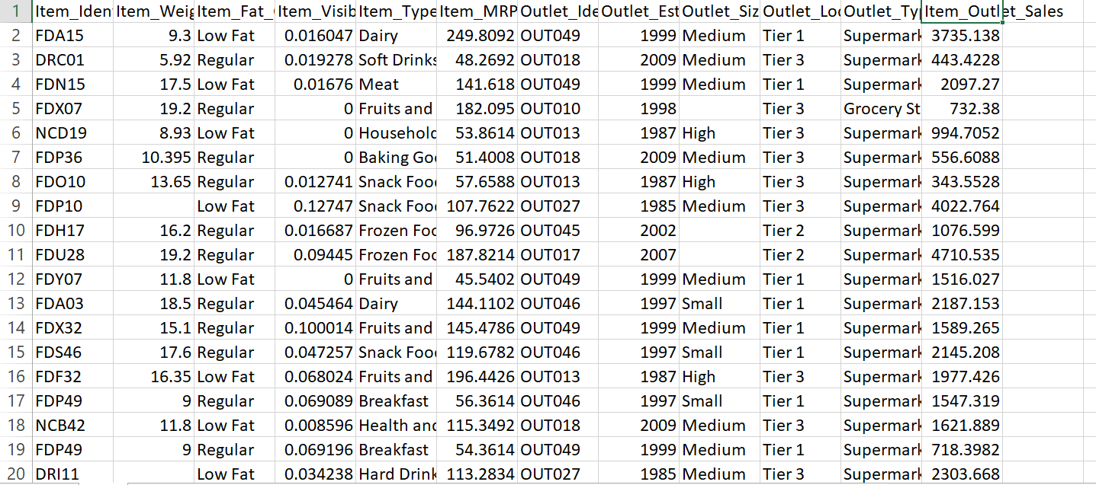
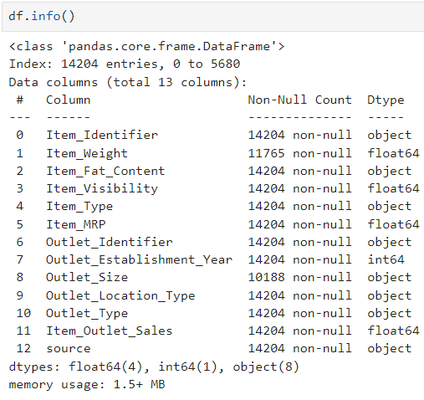
About Data Set
12 features and 1559 products
Total data contains in dataset is 14204

Slide 8
Data Preprocessing
Handling missing values in the dataset : { ‘NA’ , ‘ ‘ }
Dealing with Outliers : Like { ‘low fat’ , ’Low Fat’ , ‘lf’ , ‘Regular’ , ‘reg’ }.
Correcting Data Types : (e.g., numeric, categorical, date & time)
(one-hot encoding), converting numerical variables to the desired format.
cleaning the dataset

Slide 9
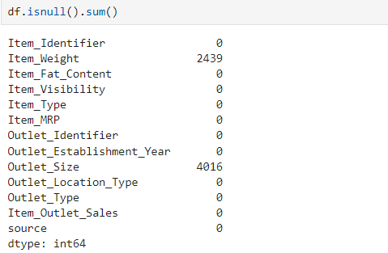
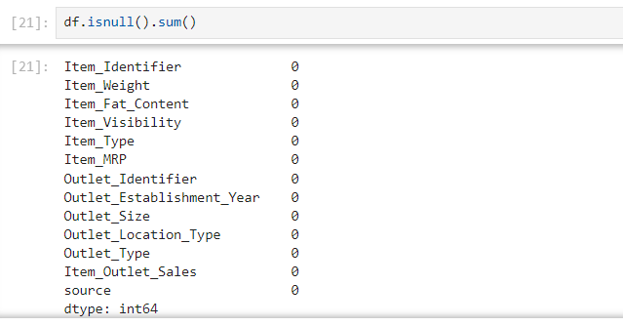
Handling Null Values

Slide 10
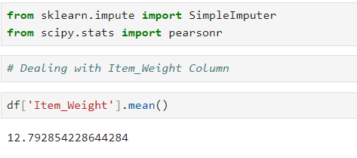
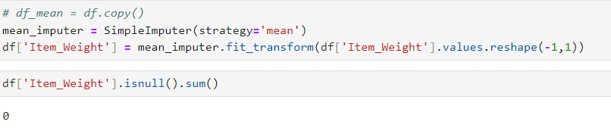
Dealing with Missing Values
mean for item_weight

Slide 11
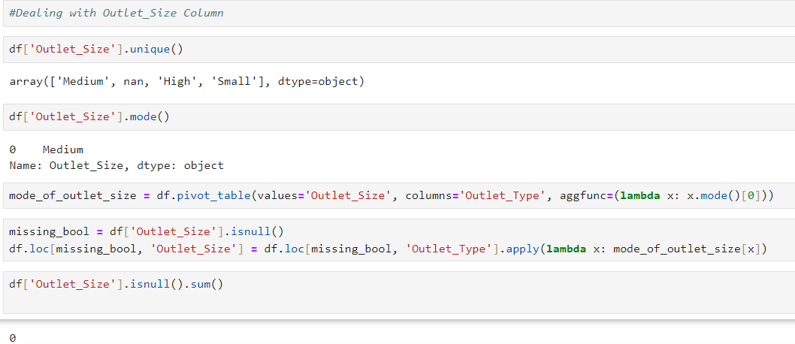
Dealing with Missing Values

Slide 12
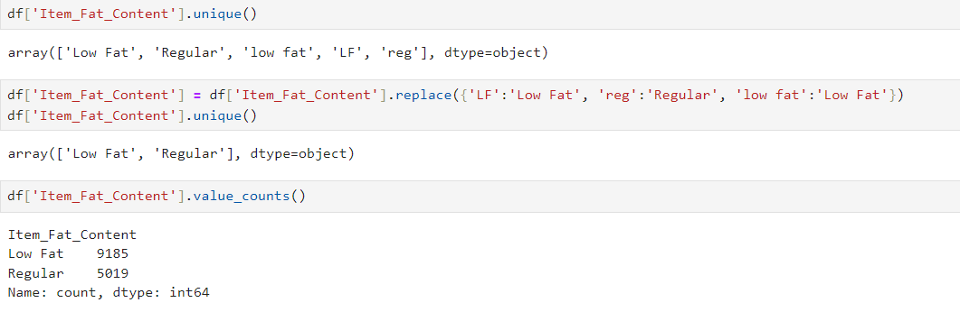
Dealing With Irregular Data

Slide 13
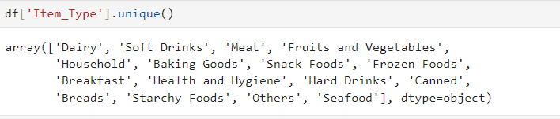
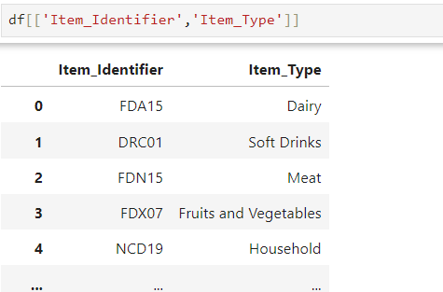
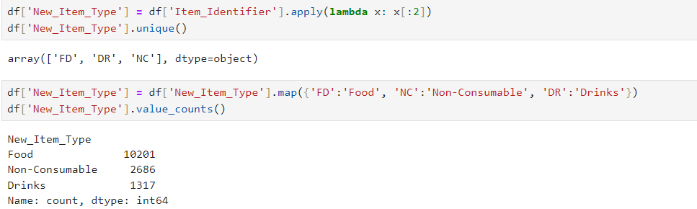
Data Preprocessing

Slide 14
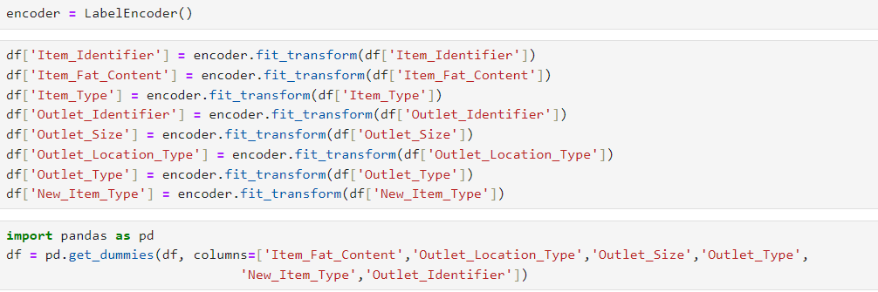
One-Hot encoding
One-hot encoding is a technique used in machine learning and data preprocessing to handle categorical variables, transforming them into a format that can be provided to machine learning algorithms.

Slide 15
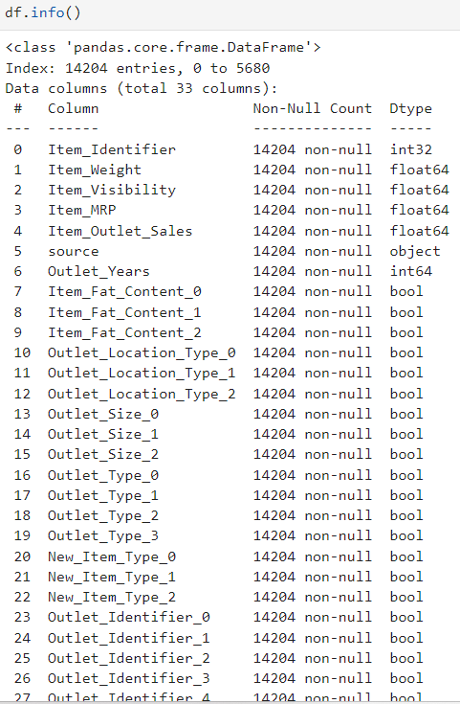
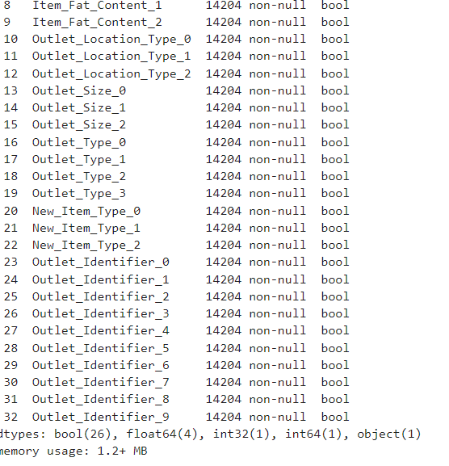
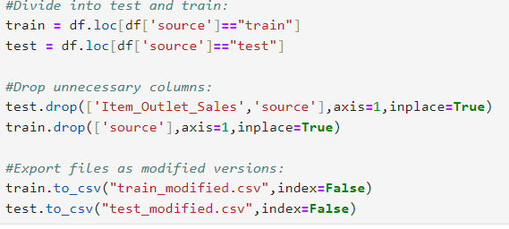
Pre processing

Slide 16
Exploratory Data Analysis(EDA)
Data Visualization:
Seaborn and Matplotlib have been used to visualize distribution of features.
Count plots for { 'Item_Fat_Content', 'Item_Type', 'Outlet_Establishment_Year', 'Outlet_Size' }.
The sns.displot function was used to create KDE plots for continuous variables.
Exploring Missing Values:
Missing values identified using df.isnull().sum() and visualized via msno.matrix() function
Feature Engineering:
New features such as 'New_Item_Type' and 'Outlet_Years' were created based on existing columns, which is a part of EDA to derive meaningful insights from the data.

Slide 17
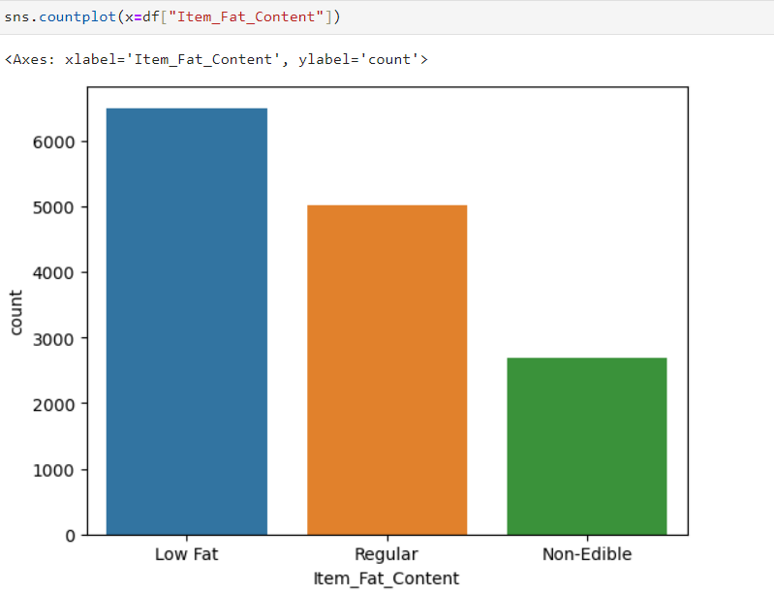
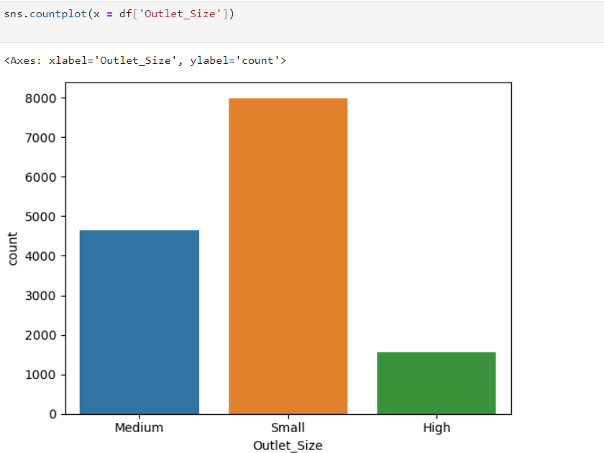
Visualizing Insights

Slide 18
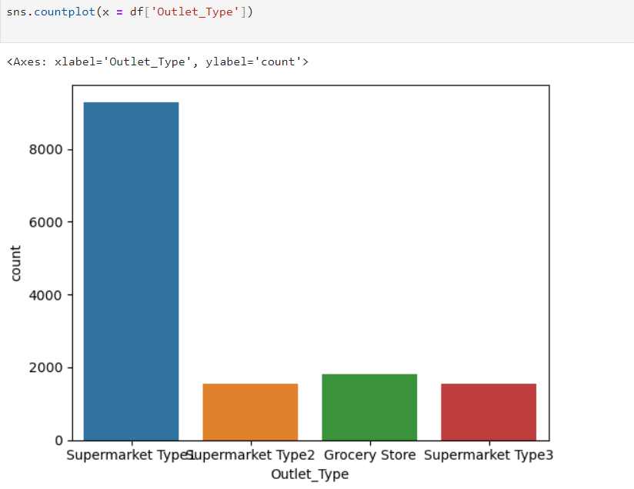
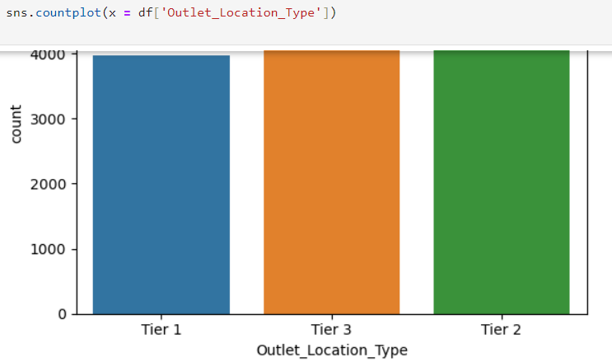
Visualizing Insights

Slide 19
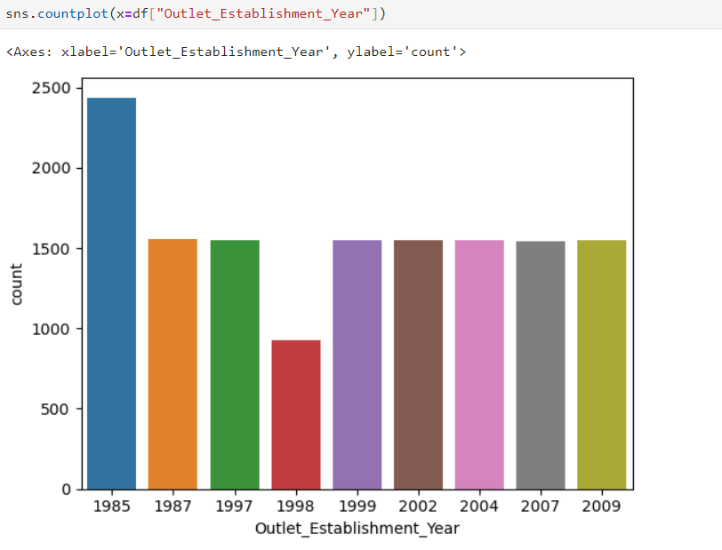
Visualizing Insights

Slide 20
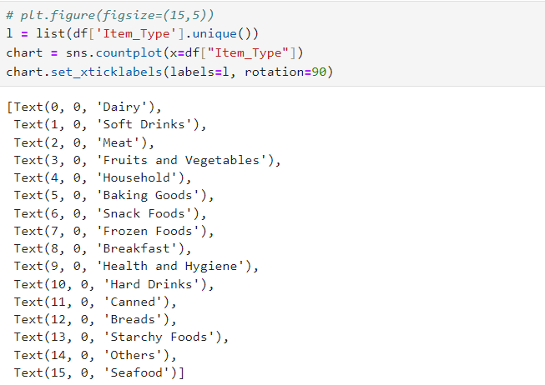
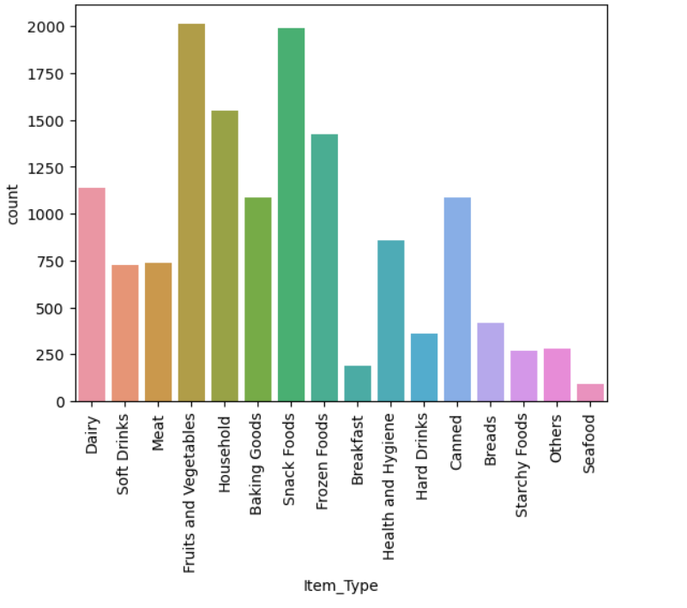
Visualizing Insights

Slide 21
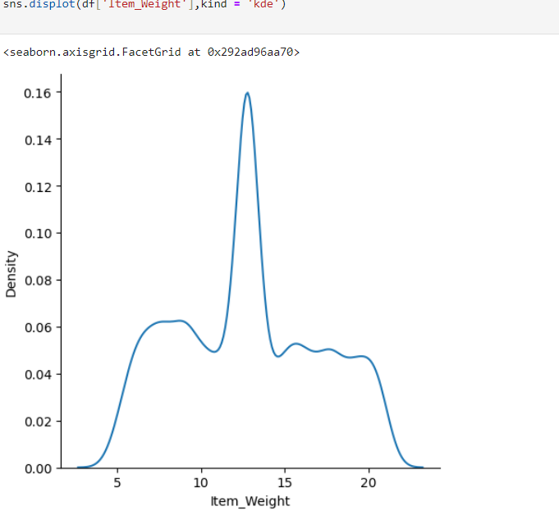
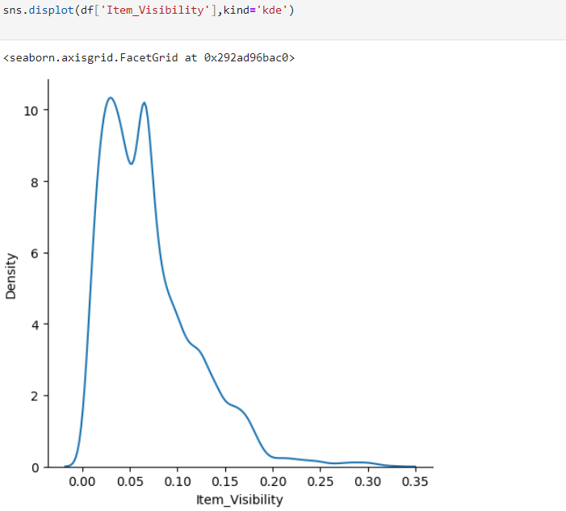
Seaborn

Slide 22

Count Plot

Slide 23
Model selection and training
Regression model
Algorithms used
What we have done

Slide 24
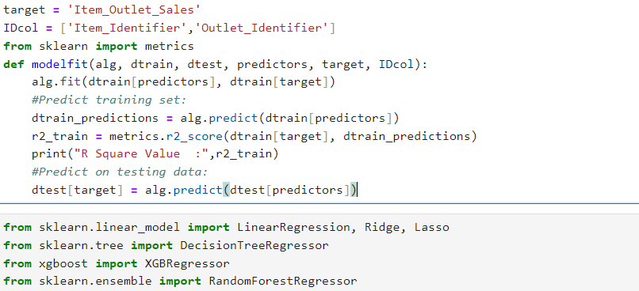
Model selection and training

Slide 25
Implementation Results of regression models:
After Selecting models we implemented the models and their outputs are displayed in the next slides.
Linear Regression
Ridge
Lasso
Decision tree
XGB Regressor
Random Forest

Slide 26
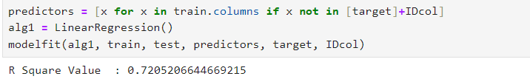
Linear regression OUTPUT

Slide 27

Ridge OUTPUT

Slide 28

Lasso OUTPUT

Slide 29

Decision Tree OUTPUT

Slide 30

Random Forest OUTPUT

Slide 31
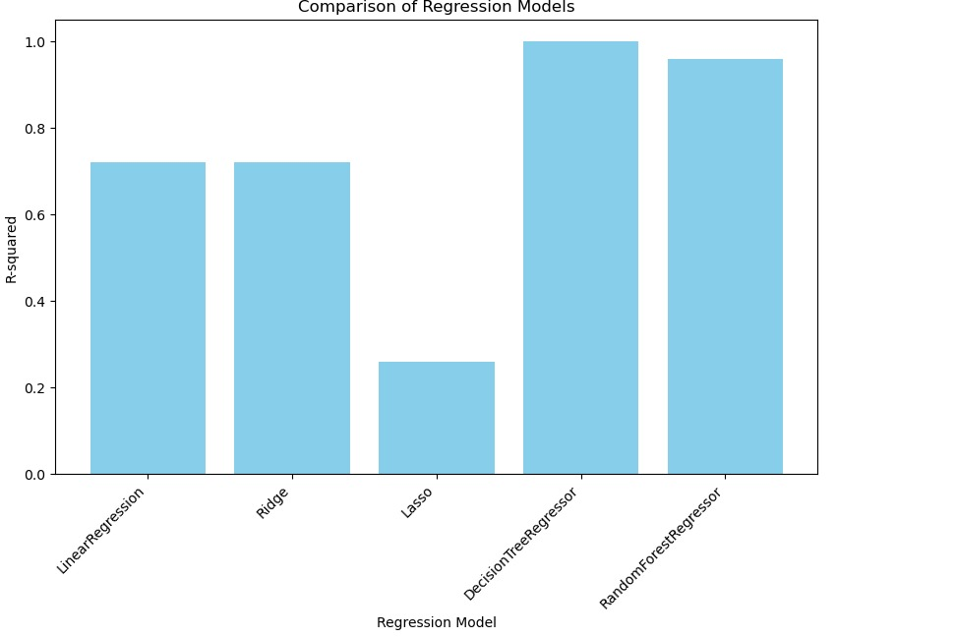
Result/Outcome
By implementing all regression models we came to know to know that decision tree performed well.

Slide 32
THANK YOU

